Slide 1
Review of Nitrogenous Natural products
Dr. Isimot T. Arowona

Slide 2
Nitrogenous compounds
Nitrogenous compound contains one or more nitrogen in heterocyclic ring system. E.g. Alkaloids
Alkaloids, means alkali-like substances.
They are basic nitrogenous compounds of plant or animal origin, which possess marked physiological action on man or animals when use in small quantities.
The nitrogen is usually contained in a heterocyclic ring system.
Alkaloids are derived from amino acids and can be synthesized as secondary metabolites by plants and some animals.

Slide 3
Nomenclature
Trivial names should end by "ine". These names may refer to:
The genus of the plant, such as Atropine from Atropa belladona.
The plant species, such as Cocaine from Erythroxylon coca.
The common name of the drug, such as Ergotamine from Ergot.
The name of the discoverer, such as Pelletierine that was discovered by Pelletier.
The physiological action, such as Emetine that acts as emetic.
A prominent physical character, such as Hygrine that is hygroscopic.

Slide 4
Importance of Alkaloids
Alkaloids play important roles in living organisms; such as strong biological effects on animal and human organisms in very small doses.
They showed anti-inflammatory, anticancer, analgesics, local anesthetic and pain relief, neuropharmacologic, antimicrobial, antifungal, and many other activities.
They serve as stimulant in drugs.
Alkaloids are useful as diet ingredients, supplements, and pharmaceuticals, in medicine and in other applications in human life.
Alkaloids are also important compounds in organic synthesis for searching new semi-synthetic and synthetic compounds with possibly better biological activity than parent compounds.

Slide 5
Functions of alkaloids
Mankind has been using alkaloid for various purposes like poisons, medicines, poultices, teas etc.
They protect plants against insects and herbivores due to their bitterness and toxicity.
They may provide nitrogen to the plant organs in case of nitrogen deficiency (source of nitrogen).
They sometimes, act as growth regulators in certain metabolic systems.
They may be utilized as source of energy in case of deficiency in carbon dioxide, especially alkaloids containing sugar moiety.

Slide 6
Some extremely poisonous alkaloids
Ergot alkaloids; it causes epidemic poisoning in the Middle Ages in Europe as a result of feeding on rye bread contaminated with the fungus.
Tubocurarine alkaloid: curare extract that contain tubocurarine alkaloids have long been used as arrow poison in hunting and warfare.
Coniine was used as a draught for execution e.g. Socrate’s execution
The wives of the Roman emperors, Augustus and Claudius, mixed Belladonna (the source of atropine) with food to murder large numbers of Romans
Egyptian henbane (Hyoscyamus muticus) contains hyoscyamine, and was used for suicidal purpose. About three berries of henbane or deadly nightshade (belladonna) can cause death in infants.
Some alkaloids causes psychotropic effects e.g. nicotine is responsible for the psychological and physical dependence of tobacco.

Slide 7
ALKALOID PHYSICAL PROPERTIES
Contains nitrogen -usually derived from an amino acid.
Most alkaloids are crystalline solids. Some are liquids that are either volatile (e.g. Nicotine and Coniine) or non-volatile (e.g. Pilocarpine and Hyoscine).
Majority of alkaloids are colorless but some are colored e.g. Colchicine and Berberine are yellow, Canadine is orange.
They give a precipitate with heavy metal iodides, and have bitter taste.
Caffeine, a purine derivative, does not precipitate like most alkaloids.
Generally, alkaloidal bases are soluble in organic solvents and insoluble in water. Exceptions include;
Bases soluble in water e.g. caffeine, ephedrine, codeine, colchicine, pilocarpine and quaternary ammonium bases.
Bases insoluble or sparingly soluble in organic solvents: Morphine and psychotrine in ether, Theobromine and theophylline in benzene.
Alkaloid salts are usually soluble in water and, insoluble or sparingly soluble in organic solvents.
Exceptions:
Salts insoluble In water; e.g. quinine monosulphate;
Salts soluble in organic solvents; e.g. Lobeline hydrochlorides is soluble in chloroform.

Slide 8
Chemical properties
In addition to carbon, hydrogen and nitrogen, most alkaloids contain oxygen in their molecules.
Few alkaloids are oxygen-free such as nicotine and coniine.
Salt formation; due to their basic character, alkaloid make salts with acids. Strong bases form salts with very weak acids.
Weak bases require stronger acids.
Dibasic alkaloids may form two series of salts.
Very weak bases form unstable salts, e.g. Piperine, Papaverine, Narcotine and Caffeine.
Amphoteric alkaloids (e.g. containing phenolic or carboxylic groups) can form salts with both acids and alkalis.
Alkaloids showing acidic characters do not form salts with acids e.g. Ricinine

Slide 9
TEST FOR DETECTION AND IDENTIFICATION OF ALKALOIDS
Reagent | Composition | Observed colour of precipitate
Meyer’s | Potassium- mercuric iodide | Creamy white (positive with most alkaloids except caffeine and dilute ephedrine)
Wagner’s | Iodine in potassium iodide | Reddish brown
Hager’s | Saturated solution of picric acid | Yellow
Dragendorff’s | Potassium bismuth iodide | Orange- reddish brown
Merme’s | Potassium cadmium iodide | Yellow precipitate

Slide 10
Classification of Alkaloid
Alkaloids can be classified based on:
The pharmacological action (biological activity)
The chemical structure (type of nitrogen, heterocyclic or non-heterocyclic and type of ring structure)
The biochemical origin (biosynthetic pathway of production in the plant) and
The taxonomical origin (plant families rich in alkaloids)
Classification of the main alkaloid in plant drug based on the ring structure:
Indole
Tropane
Quinoline
Isoquinoline
Imidazole
Pyridine-Piperidine
Purine
Steroid
Alkaloidal amines

Slide 11

INDOLE ALKALOID
Indole (C8H7N) is a weakly basic molecule consisting of a pyrrole ring fused to a benzene nucleus.
Indole alkaloids are a class of alkaloids containing a structural moiety of indole. They contain more than 4,100 known different compounds, it is one of the largest classes of alkaloids.
Indole alkaloids have gained popularity due to their diverse pharmacological activities. Some compounds are currently under clinical trials why some have being approved for human consumption.
They have being identified in plant families such as Apocyanaceae, Rubiaceae, Loganiaceae,
Some drugs from Nigerian flora and their alkaloids of the indole group are:
Drugs Alkaloids of the indole group
Rauwolfia Reserpine, Rescinamine, Deserpidine
Nux-vomica Strychnine, Brucine
Physostigma (calabar bean) Physostigmine
Catharanthus (Vinca) Vinblastine and Vincristine
Ergot Ergotamine, Ergonovine
Indole ring

Slide 12
Rauwolfia
Synonyms: Rauwolfia root, Serpentina root
Other Species: Rauwolfia vomitoria R. obscura R. Rosea
Source: Dried roots of Rauwolfia serpentina
Family: Apocynaceae.
It contains about 0.15% of alkaloids
It is mostly Propagated by seeds, roots, or cuttings, and collected when plants are 3 – 4 years old.
The bark color is usually greyish yellow, and Wood pale yellow. It is odorless, and has bitter taste.
Root size is 10 -18 cm long and 1 – 3 cm in diameter. The shape of the root is sub-cylindrical, slightly tapering.
The bark and root contain indole alkaloids such as Indoline, Indolenine, Oxyindole, Reserpine Oleo-resin, phytosterol, fatty acid, alcohol, Ajmalicine, ajmaline, rauwolfinine, rescinnamine, reserpinine, yohimbine, serpentine, serpentinine.

Slide 13
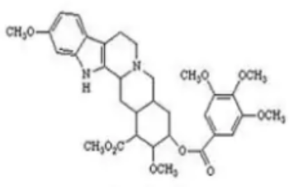
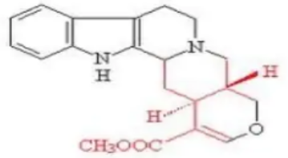
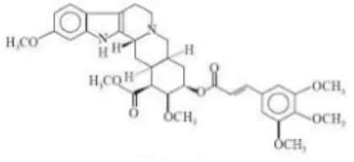
Reserpine
Ajmalicine
USES:
Reserpine: lowers blood pressure by depleting store of catecholamine at nerve ending, prevent re-uptake of nor-epinephrine at storage sites, allowing enzymatic destruction of neuronal transmitter.
Neuropsychiatric disorder like Schizophrenia
Ajmalicine: treatment of circulatory diseases, relief of obstruction of normal cerebral blood flow.
It is use against constipation and dizziness
It is use for rheumatism, edema and intestinal diseases
It is use in different countries as sedative and tranquilizer
Also useful in the treatment of cataract
Rescinnamine
Some Indole Alkaloids in Rauwolfia spp.

Slide 14
Catharanthus (Vinca)
It is the dried whole plant of Catharanthus roseus F. from the family Apocynaceae.
Folklore uses:
as an oral hypoglycemic agent. It contains 150 alkaloids, the most important are the anticancer agents vincristine and vinblastine. These are complex bisindole (dimeric indole) natural products present in small quantities in the plant material.
Pharmacological uses:
Vincristine and vinblastine are mitotic inhibitors, arrest cell division at metaphase.
They act by binding to the protein tubulin in the mitotic spindle, preventing polymerization and assembly into microtubule, thereby stopping the cell from separating its chromosomes during the metaphase; the cell then undergoes apoptosis.
Vinblastine is used mainly for the treatment of generalized Hodgkin's disease and non-Hodgkin's lymphomas.
Vincristine is used principally in the treatment of acute lymphocytic leukaemia in children. It has other applications for lymphomas, small cell lung cancer cervical and breast.
Vincristine has a superior antitumor activity compared to vinblastine but is more neurotoxic
Vindoline, Vindolidine, Vindolicine, and Vindolinine isolated from leaf extract of the plant enhanced glucose uptake (antidiabetic activity)

Slide 15
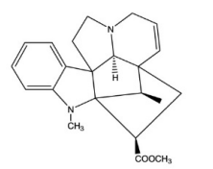
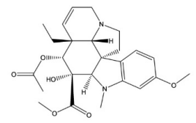
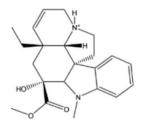
Some Indole Alkaloids in Catharanthus roseus
Vindolinine
Vindoline
Vindolidine

Slide 16
Nux vomica
Synonyms: Crow fig, Semen Strychni
It is the dried ripe seed of Strychnos nux-vomica
Family: Loganiaceae.
Nux vomica usually contains about 1.8 – 5.3 % of the indole alkaloids e.g. Strychnine and Brucine, -Vomicine, α-colubrine, pseudostrychnine, Isostrychnine, N-oxystrychnine, protostrychnine, β-colubrine and novacine.
They usually contain about 1.23 % of strychnine and about 1.55 % of brucine.
Uses
The action of the whole drug closely resembles that of strychnine. The alkaloid was formerly used as a circulatory stimulant in such cases as surgical shock, but its use is now more limited to that of a respiratory stimulant in certain cases of poisoning.
Like other bitters, strychnine improves the appetite and digestion, but it has been considerably misused as a general tonic.
Brucine: Is less toxic than strychnine and used commercially as an alcohol denaturant
Brucine showed potent inhibitory effects against both the early- and late-phase of pain stimuli (analgesic activity).

Slide 17
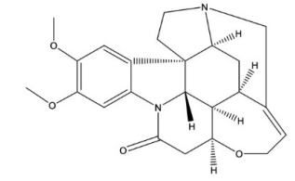
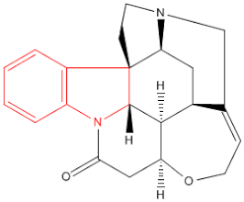
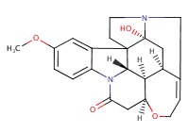
Brucine
Strychnine
β-colubrine
Some Indole Alkaloids in Strychnos nux-vomica

Slide 18
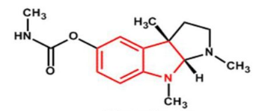
Physostigma venenosum (Calabar bean)
Calabar beans is the dried ripe seed of Physostigma venenosum (Leguminosae)
It contains several alkaloids such as Physostigmine (eserine), eseramine, geneserine. Isophysostigmine, physovenine, Nor-physostigmine, Calabatine and calabacine
The main alkaloid, physostigmine, is about 0.15 % present in the plant.
It is derived from amino acid tryptophan.
On exposure to air it oxidizes into a red compound, rubreserine, thus, it should be protected from air and light.
Uses
It reversibly inhibits AChE (choline esterase) and enhance the effect of endogenous acetyl choline.
Physostigmine salicylate salt is used for contracting the pupil of the eye.
Physostigmine is used in the treatment of overdoses of drugs with anticholinergic actions, such as atropine.
It has also been investigated as an intravenous injection for reversing the effects of a number of sedatives.
For Alzheimer's disease: it induces slight improvement in intellectual and cognitive performance.
Physostigmine

Slide 19

Ergot alkaloids
Ergot is a fungal infection that has infected rye and other plants since farming began and ergot alkaloids, were found to have useful medicinal properties.
Ergot is the dried sclerotium of a fungus, Claviceps purpurea (Clavicipitaceae), that arises on the ovaries of the rye plant, (Secale cereale - Gramineae).
The main source of the crude drug is the field cultivation on rye.
Cultivated ergot may contain up to 0.5 % of total alkaloids,
The ergot alkaloids can be detected in flour by using UV light where contaminated flour will show violet spots.
Ergot was known to cause gangrene in the limbs of those who had ingested infected bread, but later its first medicinal property as a powerful oxytocic (facilitating childbirth) was discovered, and more recently its derivatives have been used in the treatments of migraine
Uses
Whole ergot preparations were traditionally used in labour to assist delivery and to reduce post-partum hemorrhage, but has been largely replaced in the pharmacopoeias by the isolated alkaloids.
Ergometrine causes vigorous contraction of the uterus. It is mainly used as an oxytocic in order to aid delivery or to prevent postpartum hemorrhage.
Ergometrine is soluble in water or in dilute alcohol. It is often known, particularly in the USA, as Ergonovine
Ergotamine and the semi-synthetic dihydro-ergotamines salts are employed as analgesics, for the treatment of migraine headache. It act as cerebral vasoconstrictors.
Ergotoxin methane-sulphonates is a Lysergic acid diethylamide (LSD) derivatives, prepared by partial synthesis from lysergic acid, is a potent specific psychotomimetic, cause CNS stimulation and it is drug of abuse .
Ergot on rye

Slide 20
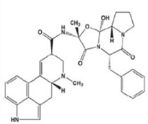
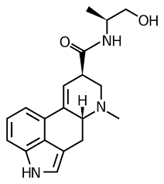
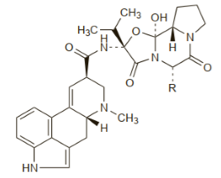
Ergotamine
Ergometrine
Ergotoxin

Slide 21
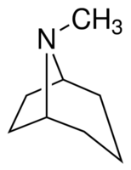
Tropane Alkaloids
The tropane alkaloids are dicyclic compounds which have cyclo octane nucleus, and commonly found in plants of three families;
Solanaceae, Erythroxylaceae and Convolvulaceae
Drugs in these class of alkaloids include:
Drugs Alkaloids
Belladona, Atropine
Datura Hyoscine (scopolamine)
Coca Cocaine
Hyoscyamus species Hyoscyamine, Hyoscine
Tropane

Slide 22
BELLADONNA
Botanical source: Atropa belladonna
Family: Solanaceae
Part used: Dried leaves and flowering tops.
Chemical Constituents: Atropine (0.4 – 1 %), Hyoscyamine, Apoatropine, Belladonnine, Scopoletin
Addition of ammonia to the alcoholic solution of scopoletin shows blue florescence. This test is useful to detect Belladonna poisoning.
Uses
Consumption of Belladonna checks excessive perspiration of patients suffering from tuberculosis
Atropine is a cholinergic blocking agent ,occupying the postsynaptic receptor sites ,preventing the normal neurotransmitters from acting
Antispasmodic,it relax the smoothe muscle of intestine
It causes mydriasis when apply directly on the pupil of eye and used in the ophthalmology during examination of eye.
Atropine sulfate is an anticholenergic used in surgery to control bronchial, nasal pharyngeal and salivary secretions.
Atropine has a stimulant action on the central nervous system
Atropine is an antidote to poisoning with eserine (physostigmine), pilocarpine , newstigmine and organophosphorous insecticides.

Slide 23
DATURA
Botanical sources: Datura metel, Datura stramonium etc.
Family: Solanaceae
Part used: Dried leaves and flowering tops
Chemical Constituents: Hyoscine (scopolamine) is the main alkaloid, hyoscyamine (scopoline) and atropine (0.2 %) are present in less quantities.
Uses
Hyoscine exhibits anticholinergic and CNS depressant effects.
The drug is used in cerebral excitement, asthma and in cough.
Hyoscine lacks the central stimulant action of atropine; it has sedative properties and employed in pre-operative medication, for pre-anesthetic sedation.
Hyoscine is also used in ophthalmic practice to dilate the pupil of the eye.
Hyoscyamine sulfate is an anticholinergic, and also has been used to treat acute arrhythmias.
Hyoscyamine is used to control gastric secretion,
Decrease motility of smooth muscles (antispasmodics) e.g: in abdominal cramps.
Used to reduce rigidity and tremors in Parkinsonism.
Hyoscyamine occur as tablets, capsules, oral drops and injection in pharmacy.

Slide 24
Hyoscyamus niger
Hyoscyamus (Henbane) consists of the dried leaves and flowering tops of Hyoscyamus niger (Solanaceae).
Hyoscyamine and hyoscine are the principal alkaloids.
It is required to contain not less than 0.05% of total alkaloids calculated as hyoscyamine.
Henbane resembles Belladona and Stramonium in action but is somewhat weaker.
The higher relative proportion of hyoscine in the alkaloid mixture makes it less likely to give rise to cerebral excitement than does Belladona.
It is often used to relieve spasm of the urinary tract .

Slide 25
COCA LEAVES
Botanical source: Erythroxylon coca
Family: Erythroxylaceae
Part used: Leaves
Chemical Constituents: Cocaine, cinnamoyl cocaine, α-truxilline, Cocamine.
Uses
As cerebral and muscle stimulant, especially during convalescence
To relieve nausea, vomiting and pains of the stomach without upsetting the digestion.
Cocaine also has local anesthetic action on skin and mucous membrane;
It is used as dental anesthesia and minor local surgery of ophthalmic, ear, nose and throat.
In the control of severe pain for patients with terminal cancer.
Chemical structure of cocaine has lead to several synthetic anesthetics like novocain, stovaine, procaine etc.

Slide 26
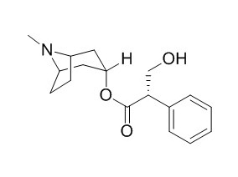
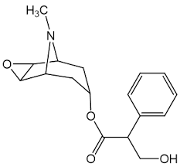
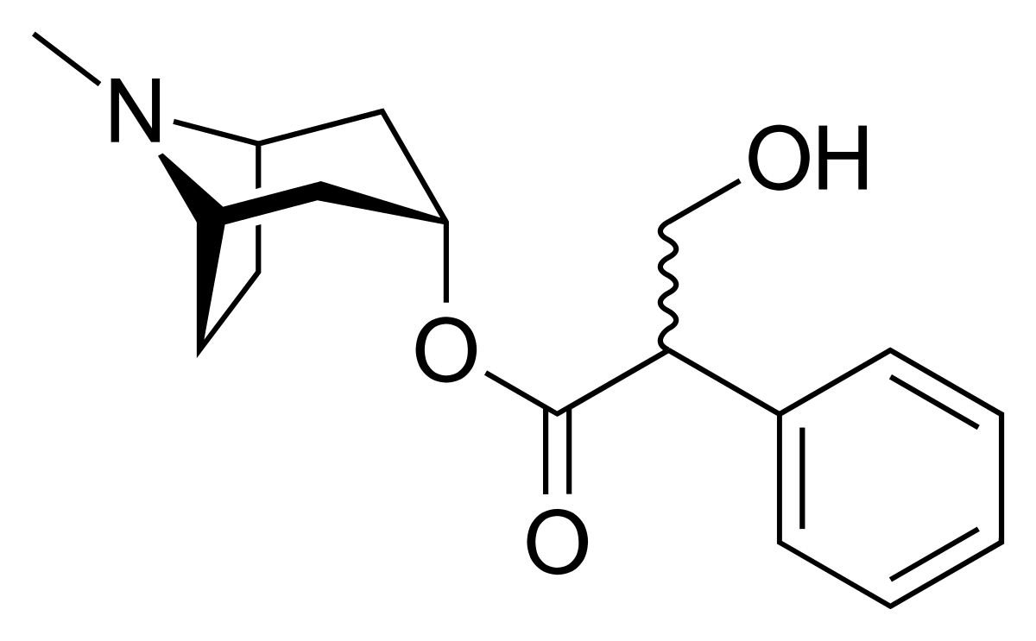
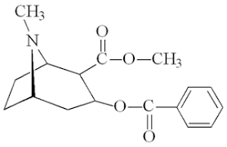
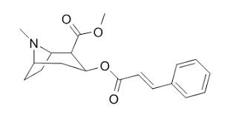
Atropine (D – Hyosciamine)
L - Hyosciamine
Hyoscine
Cocaine
Cinnamoyl cocaine

Slide 27

Isoquinoline Alkaloid
It was first isolated from coal tar in 1885
Belongs to large family, with over 400 members
Its found in plants families like;
Papaveraceae, Rubiaceae, Loganiaceae, Menispermaceae etc
Drugs in this class of alkaloid include:
Drugs Alkaloids
Opium Morphine, Codeine, Papaverine
Ipecac Emetine
Curare Tubocurarine
Isoquinoline

Slide 28
Opium
Synonym: : Poppy Latex, Gum opium or Raw opium
Source: Papaver somniferum
Family: Papaveraceae
Part used: is the air dried milky exudates obtained by incising the unripe capsules of the plant.
It is derived from phenylalanine and tyrosine
The cultivation of Opium poppy is controlled internationally by the International Narcotics Control Board of the United Nations.
It has a strong odor, Bitter taste, and different colors depending on the type of opium (Indian opium is dark brown; Turkish opium is chocolate brown).
Chemical Constituents: Opium contains more than 19 alkaloids, some of which are combined with Meconic acid (dicarboxylic acid), others with sulfuric and acetic acid and some as free alkaloids.
There are 3 main classes of Opium alkaloids:
Phenanthrene alkaloids e.g. Morphine, Thebaine, Codeine.
Benzyl Isoquinoline alkaloids e.g. Papaverine, Noscapine (Narcotine).
Phenyl alkyl amine alkaloids e.g. Narceine

Slide 29
USES
Morphine is a powerful analgesic used in cases of severe pain such as post-operative pain, bone fractures, cancer patients and in cases of angina (severe pain in the chest, most times spreading to the shoulders, arms, and neck, due to an inadequate blood supply to the heart).
Morphine has a high potential for addiction and abuse.
Its used as remedy in convulsion
It precedes the use of anesthetics so as to increase their efficacy
Its also used as an antagonists for poisonous effects of other alkaloids such as strychnine, atropine, phytostigmine.
Common side effects include drowsiness, vomiting, and constipation.
Codeine: analgesic, although weaker than morphine, produces less tendencies to addiction, relieves local irritation in bronchial tract, antitussive and causes constipation and hypnosis (to induce consciousness)
Papaverine: smooth muscle relaxant of bronchial, intestinal and blood vessels and an anti-tussive in combination with Codeine sulfate.
Narcotine: cough reflex depressant
Heroin is the synthetic diacetyl derivative of morphine, narcotic and Its analgesic property is more potent than morphine

Slide 30
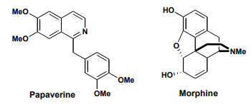
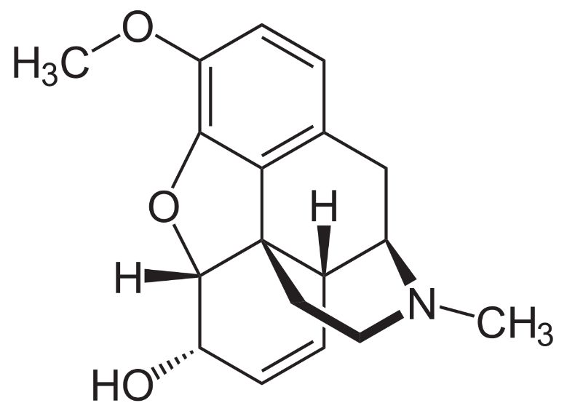
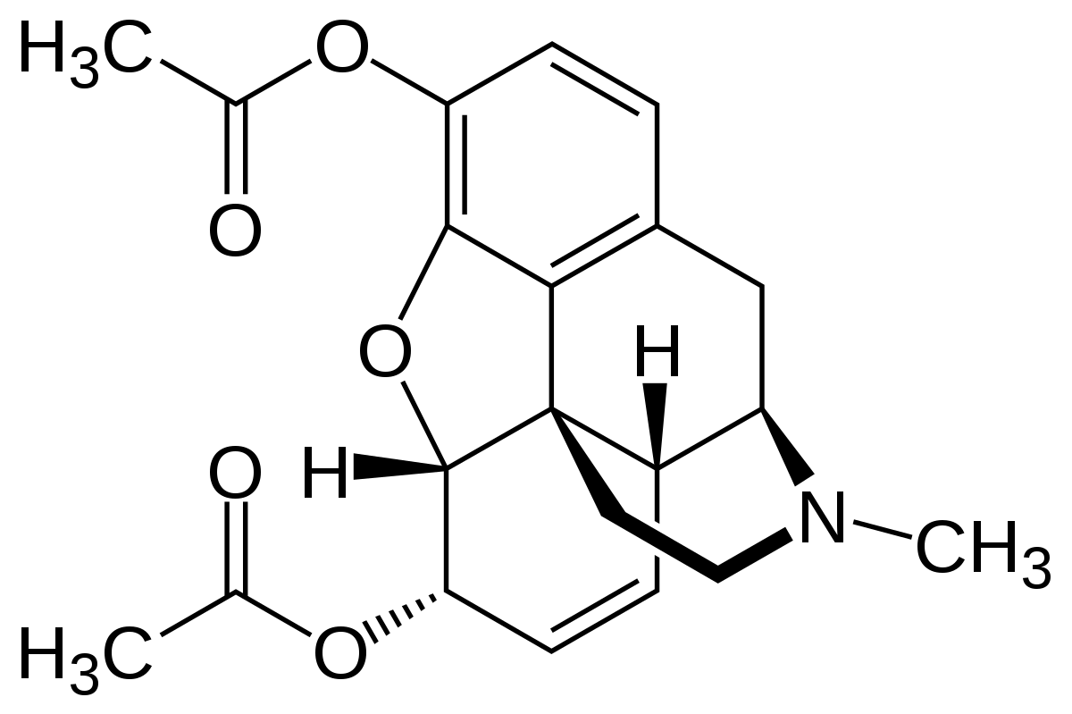
Codeine
Heroin

Slide 31
Ipecacuanha
Synonym: Ipecac
Source: dried roots and rhizomes of Cephalis ipecacuanha, C. acuminate
Family: Rubiaceae
It contain noting less than 0.2 % alkaloids, from which emetine is about 50 %
Constituents: it contain Isoquinoline alkaloid of phenolic and non phenolic group. E.g. Emetine, o-methyl psychotrine (non-phenolic), Cephaeline, Psychotrine (phenolic),
Uses
Emetine is a potent antiviral that acts on many viruses in low range
It serves as an anti-protozoal but it is myotoxic and cardiotoxic.
It is used to induce vomiting
Cephaeline also induces vomiting by stimulating the stomach lining
Psychotrine has anti-viral property

Slide 32
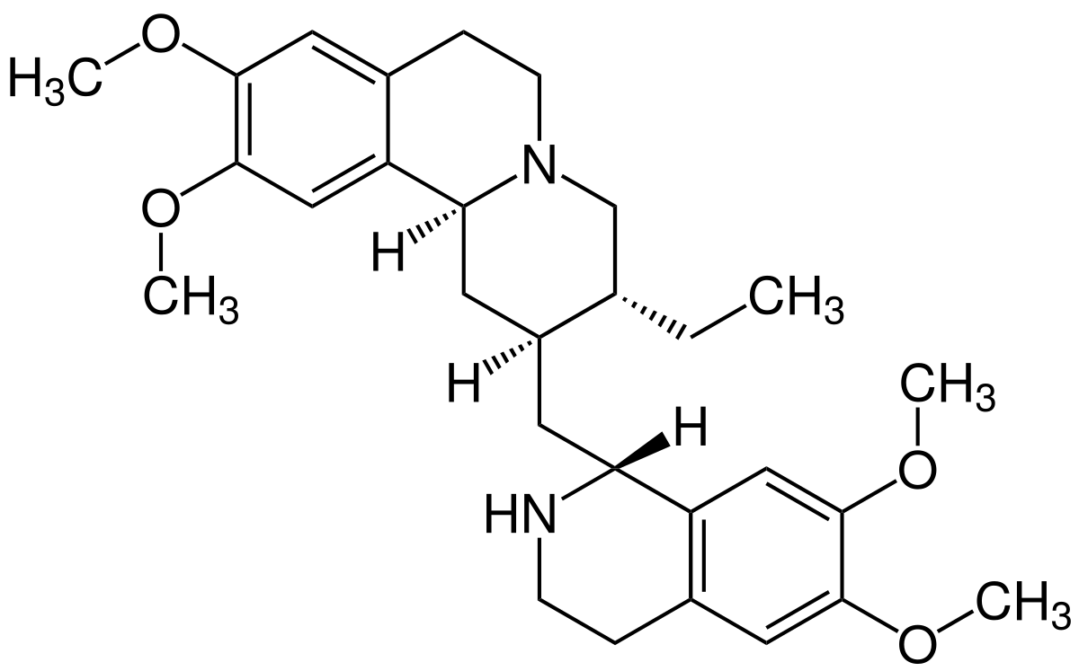
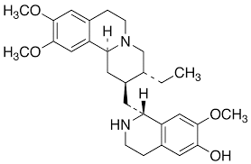
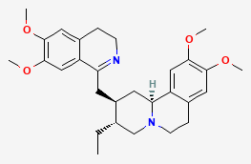
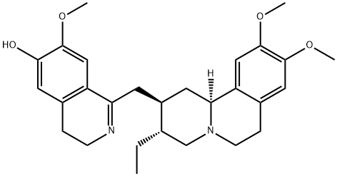
Emetine
Cephaeline
o-methyl psychotrine
Psychotrine

Slide 33
Curare
Synonym: South American arrrow root poison
Sources: Chondrodendron tomentosum, Strychnos castelnaea, S.toxifera (Loganiaceae), Stephania, Menispermum, Cyclea (Menispermaceae), Cocculus Daphandra (Monimiaceae), Magnolia (Magnoliaceae), Berberis (Berberidaceae).
Some of these plants contain highly poisonous substances. The extract of all such plants is called curare.
Constituents: (+)- Tubocurarine (bisbenzyl iso quinoline moiety and the most potent), Curine, Curarine, Isochondrodendrin, Cycleanine, Chondrocurine, Tomentocurine.
(+) - Tubocurarine chloride is use as;
Neuromuscular blocking agent
Skeletal muscle relaxant during surgical operations; to relax abdominal muscles due to which lower and safer dose of general anesthesia is applied
Occasionally used to aid myasthenia gravis (muscular weakness)

Slide 34
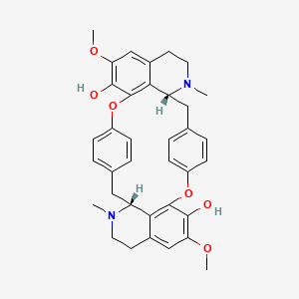
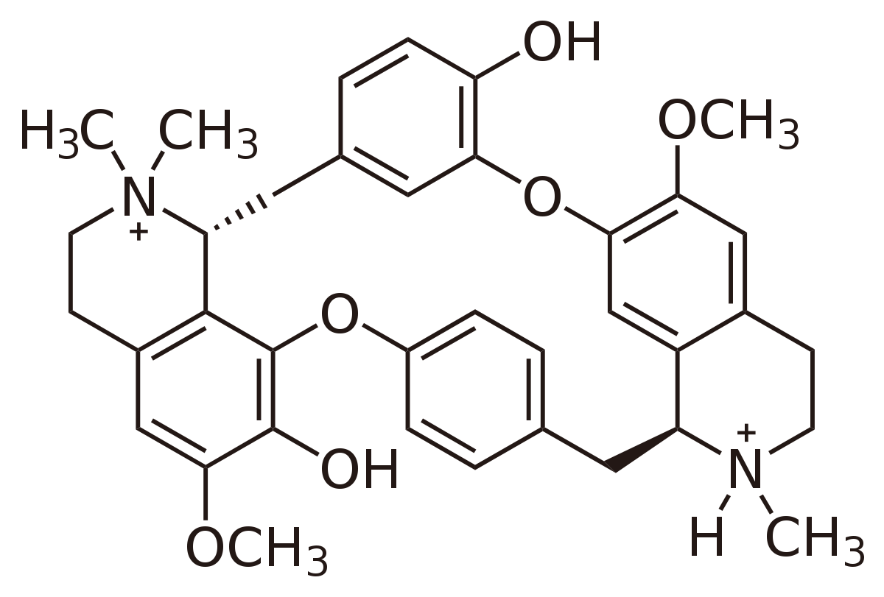
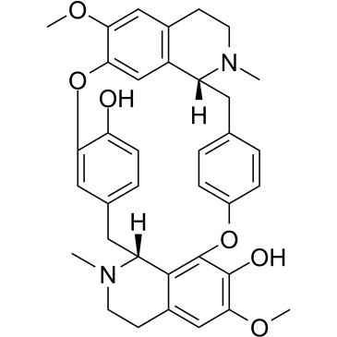
Tubocurarine
Isochondrodendrin
Curine

